Slide 1

Semester Project: Link Checker
By: Carlos Lucero

Slide 2
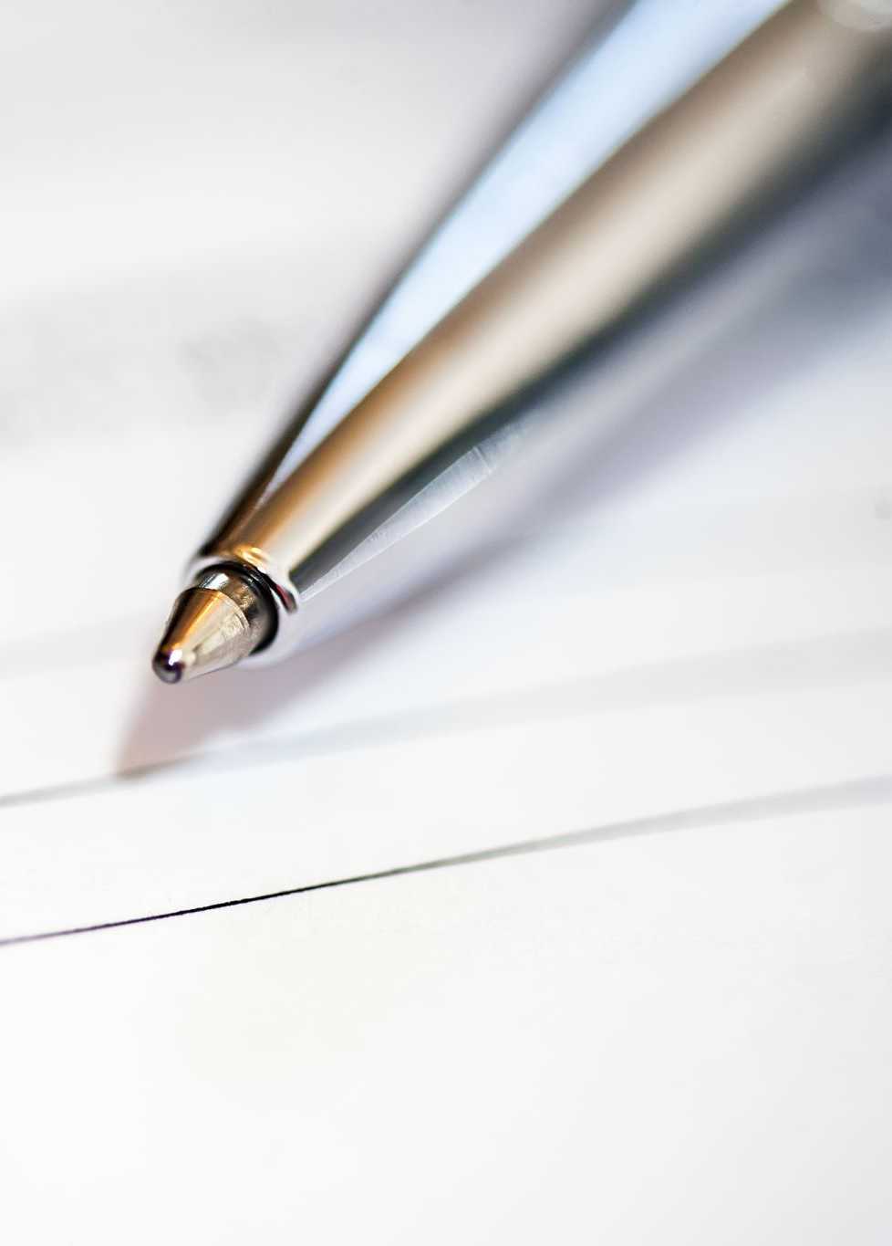
What Does it Do?
Reads URLs from files or accepts manual input from user
Uses python request library for status codes and http requests
Uses the status codes to give back list of URLs and tells user if they are broken
Also gives info about URL status

Slide 3

How Does it Work?
Uses requests library to get status code
Uses status code to determine if link is broken
Http status codes:
1xx: Informational, doesn’t indicate broken link
2xx: Successful, Link is working
3xx: Redirection, Link is outdated
4xx: Client error, Link is broken on user side
5xx: Server error, Link is broken on server side

Slide 4
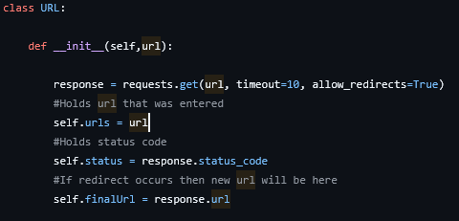
URL object:
Encapsulates all the URL data in URL object
Handles request logic in initialization of object

Slide 5
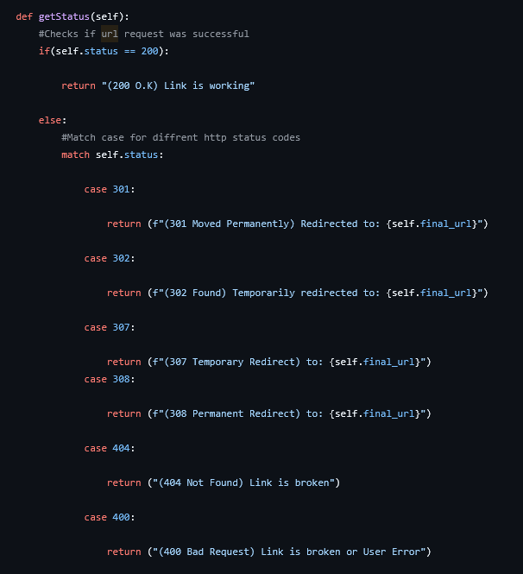
Status Code Match Case:
Since status codes are a pattern, I used a match case
Not all status codes mean a link is broken

Slide 6

Demo Time

